Slide 1
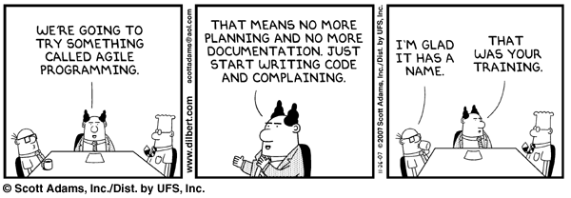
Agile Project Management

Slide 2

What Is Agile?
Agile is a group of software development methodologies
  Scrum
  Extreme Programming (XP)
  Lean
  Etc.
Key Characteristics:
  Small increments
  Adaptive to change
  Collaborative

Slide 3
Defining Agility
Individuals and interactions over processes and tools
  Encourage engagement between functional areas
  Avoid using documents to hand off information
Working software over comprehensive documentation
  Focus on incrementally attacking the problem
  Stay releasable

Slide 4
Defining Agility
Customer collaboration over contract negotiation
  Prioritize based on business value
  Work together to ensure that value is maximized
Responding to change over following a plan
  Plan just enough (no more than necessary)
  Defer to the last responsible moment
  Stay flexible and leverage what you’ve learned

Slide 5
Why Do It?
It results in better software
  Higher productivity (you get what you need quicker)
  Higher quality
  More customer satisfaction
  More visibility
  Better morale

Slide 6

Roles
Product Owner
Scrum Master
Team Member

Slide 7
Product Owner
Prioritizes the backlog
Communicates what is important … and what is not
Is a proxy for the customer

Slide 8

Scrum Master
Responsible for the process
Facilitates agile meetings
Helps to remove road blocks

Slide 9

Team Member
Signs up for work
Asks questions
Collaborates with others
Communicates progress / blocking issues
Makes it happen

Slide 10

What Does It Look Like?
Backlog
Release
  Release Planning
  Iterations (1-4 weeks long)
    Iteration Planning
    Daily standup
    Demo
    Iteration Retrospective
  Release Retrospective

Slide 11
The Backlog
A ranked list of stories
What is a story?
  A scenario that we must do work to implement which results in business value
  Typically in the form of: “As a <type of user>, I want <feature> so that <business value>”
  Good stories meet the INVEST criteria
Notes:
Mike Cohn proposes this form of story naming.
Bill Wake came up with the INVEST model.

Slide 12

Example
Post a Job
As a recruiter I want to be able to post a job to the web site so that I can generate interest in the position.

Slide 13
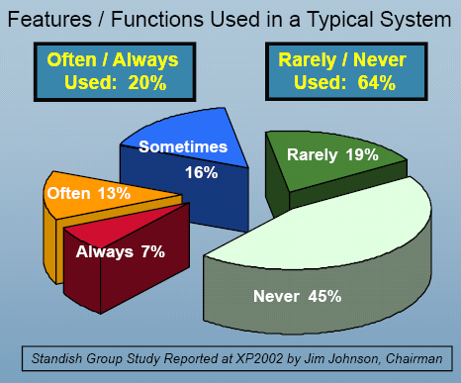
Why Prioritize?

Slide 14
Prioritization Doesn’t Stop
The product owner re-prioritizes after each iteration
  We’ve learned more about the business
  Let’s take advantage of that
The further down the list something is, the less defined it will be and the less important it is to prioritize precisely

Slide 15
What Does an Iteration Look Like?
Daily Stand up Meeting
Done since last meeting
Will do for next meeting
Obstacles
24 hours
Iteration
Iteration Planning Meeting
Review Product Backlog
Define Iteration Goals
Estimate Iteration Backlog
Commit
1 week
to 1 month
Demo
Show off what you’ve done
Backlog tasks
expanded
by team
Iteration Backlog
Potentially Shippable
Product Increment
Product Backlog
As prioritized by Product Owner
Retrospective
Inspect and Adapt
Vision and Release Plan

Slide 16
Iteration Planning
Define scope as a team
Define a clear understanding of “done”
Plan just enough that you can commit
Notes:
This is the first level where you actually commit (at the team level). You plan out what you're going to accomplish in the next iteration (a matter of weeks). You get a clear understanding on what done is (acceptance criteria).
Kanban has the potential to change thinking on this. Pull as you need. No estimation / commitment.

Slide 17

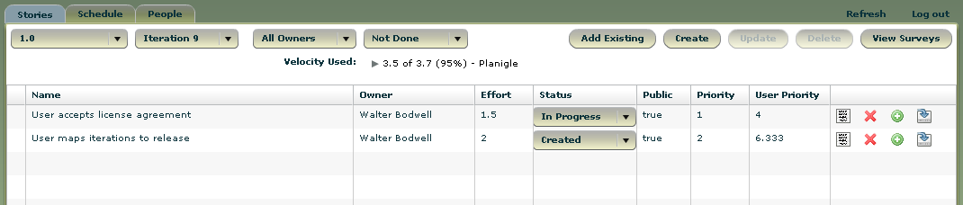
Before you Start
Well Groomed Product Backlog
  Prioritized
  Estimated
Iteration Theme/Goal
Estimated
Prioritized

Slide 18
A Typical Iteration Planning Session
Discuss Logistics
Review iteration goals
For each story (in Priority Order):
  Understand it
  Task it out
Stop when “full” and commit
Typical Duration: 1-4 hours
Attendees:
Product owner
Scrum master
Delivery team
Materials:
Stories (cards or online)
Task planning material (cards, whiteboard, online)
Planning/estimation materials (e.g. planning poker cards)

Slide 19
Discuss Logistics
Review Historical Velocity
Review Team Availability
  Holidays / Vacations
  Meetings
  L3 Support, outside commitment, etc
Review the Definition of Done

Slide 20

Review Iteration Goal(s)
At a high level, what are we trying to accomplish this iteration
Examples:
  Improve reporting
  Improve performance
  Get ready for beta

Slide 21
Understand the Story
Discuss the story
Discuss why it is important
Elaborate on acceptance criteria/tests
Make priority adjustments
Break down as needed

Slide 22

Task out the Story
Define tasks
Estimate the work involved
Double check ability to commit
The Product Owner can help in avoiding less valuable work
Notes:
Track velocity from iteration to iteration so you can learn from past experience.

Slide 23

Repeat
Until the team cannot take on more
Split stories as necessary

Slide 24

Commit
Everyone agrees the iteration is doable
Use disagreement and uneasiness in team members to drive out hidden risks, tasks, and issues
Drive agreement with a fist of five
    Absolutely, no question
    I think this is good and will make it happen
    I can support this
    I’m uneasy about this and think we need to talk about it more
    Let’s continue discussing this idea in the parking lot

Slide 25
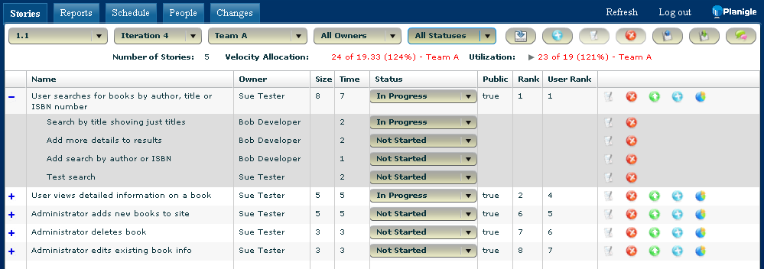
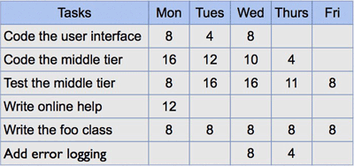
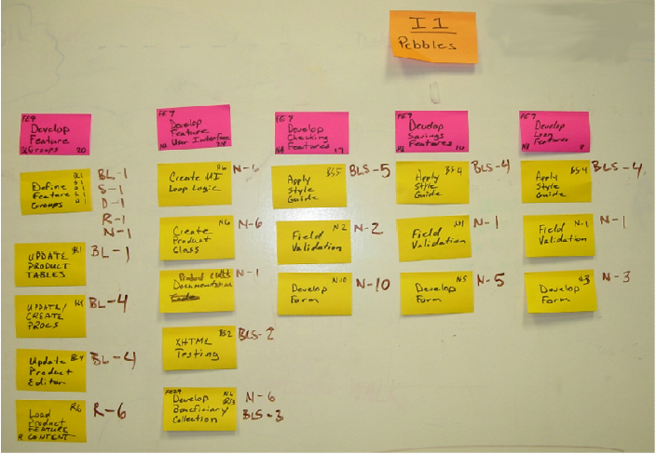
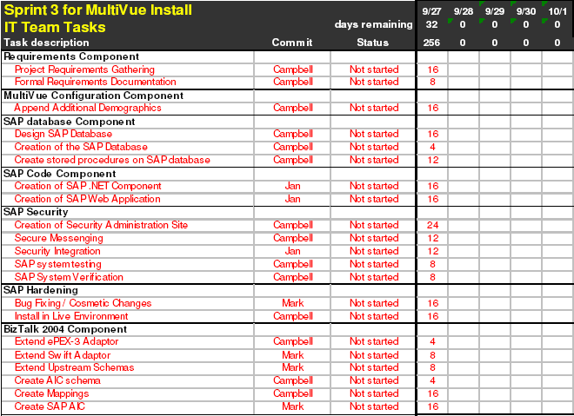

Managing your Tasks

Slide 26

Daily Standup
High Value
What did I do yesterday?
What will I do today?
What’s blocking me?
For the team
Quick
Parking Lot
Notes:
This is where individuals commit to what they're going to get done in the next day. It helps to ensure that the team is communicating. It encourages collaboration and highlights issues which are blocking the team.

Slide 27

Demo
Show off what you got “done” in the iteration
Should be from the user’s perspective
No slides
No code
Just working software
If a customer could attend your demo,
you’re doing it right
Notes:
Communicate and Get Feedback

Slide 28

Retrospective
Review the process over the last iteration
What went well?
What went poorly?
How can we do things better?
Take the top 1-3 items and make sure you make progress on them in the next iteration
Improve

Slide 29
Estimating
Identify a medium sized story that is well understood; call it a 5
Now estimate other stories relative to that
Is it about the same, ½ as difficult, twice as difficult?
Use Fibonacci numbers: 1, 2, 3, 5, 8, 13, 21
If bigger than that or if too hard to estimate, split the story
Tackle as a team; Planning poker can help (www.planningpoker.com)

Slide 30
Velocity
Now that stories have sizes, you can track how many points you typically get done in an iteration
Only count points for stories that get accepted in the iteration
You can now use this to predict future completion rates

Slide 31

Structuring Teams
It is preferable to have each team have the ability to complete its work by itself
In other words, instead of a team per component, have teams with members who have knowledge of each component that will need to change to deliver something

Slide 32
Divvying Things Up
Your goal is to divvy things up so that teams are working on items of around the same priority
If each team able
to get 3 blocks in
the release,
the highlighted
stories won’t
make it
By better distributing
stories amongst the
teams, look which
stories won’t make it
Bad
Good

Slide 33
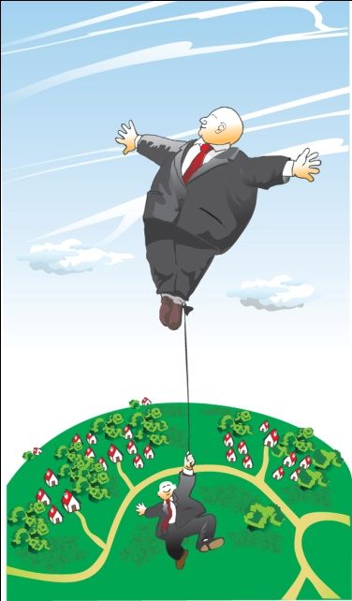
Dependencies
Approaches (go with the first one you can):
  Structure the teams so that a single team can solve the problem end to end
  Do the work within the same iteration
  Implement the service and then use it
  Stub out the service and implement it later
Make sure the dependent teams
  (including external ones) are represented at
  release planning

Slide 34

Release Planning
Kick off / Overview
Break Out Sessions
Review Results
Notes:
On release planning day itself, start with an overview to give everyone a clear picture of what you’re trying to accomplish. Break out into individual teams to do the real work. Get all the disciplines involved. Cross pollinate between teams. Bring it back together at the end so everyone knows / understands the results.

Slide 35

Release Planning Deliverables
Plan for each Iteration
Assumptions
Dependencies
Risks
Notes:
Iteration Plan
High level stories for each iteration
Name based on what the user gets out of that story
Estimates for each story (in terms of how many people for that iteration)
Assumptions
Dependencies
Risks

Slide 36
Release Planning Wrap Up
Go through each iteration for each team
Are things synched up across teams?
Are you attacking the most important stories?
Does the team believe in the results?
Notes:
Go through each iteration for each team and discuss:
Iteration Stories
Assumptions
Dependencies
Risks
Are things synched up across teams?
Are you attacking the most important stories?
At the end, poll to find out whether the team believes in the result. This is a good time for a fist of five.

Slide 37
After The Meeting
Capture the results in your tool of choice
Update after each iteration
Notes:
Don’t do it and forget about it. Update frequently to keep everyone on the same page.
Backlog should be updated at least once an iteration. Stories mapped to future iterations should be updated as well based on what you’ve learned.

Slide 38

Anti-Goals of Release Planning
Release Planning is not a commitment!
Notes:
You are not committing to individual estimates
You are not committing to which features will be done
You’ll learn more as you go; Priorities will change
Those items higher in the priority list have a higher likelihood of being done

Slide 39
Communicating the Future
Themes give you room to be flexible
  We know we’re going to do something in this area
  We’ll decide as we go how much
If a customer is asking about a particular feature, you can get into a discussion of priorities
  Well, that’s important, but we think this and this are more important, what do you think?
Demos are a potential opportunity to get a customer involved
Smaller, incremental releases generate feedback on what to dig into in more detail

Slide 40
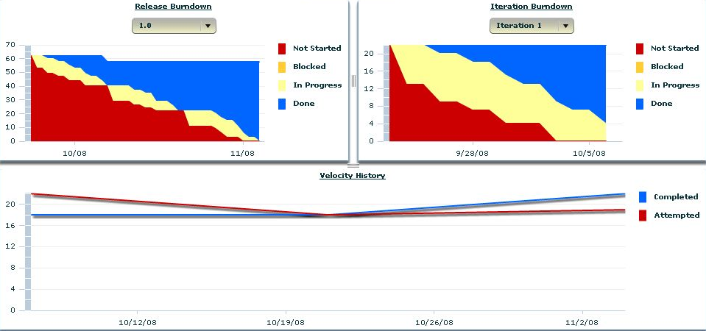
Tracking the Release

Slide 41

Managing Risk
Waterfall
Agile
Time, scope and resources “fixed”
Changing one affects the others as well as quality
Manage the plan
Try to minimize change
Time, resources and quality fixed
Changing time or resources affects scope
Manage the priorities
Change as you learn more

Slide 42

Life in an Iteration
Once in an iteration, scope is fixed
Do the work in small increments
Work closely with others
It isn’t done until it is really done
If it doesn’t add value, don’t do it (or minimize)
Leave decisions to the last responsible moment
It is a team effort

Slide 43
Self Organizing Teams
The team members know how they can best contribute
They figure out how to divvy the work up / attack the problem
The scrum master facilitates and is part of the team

Slide 44
Feedback is key
Do a little
Get feedback
Respond to feedback by doing a little more
Automation helps decrease time to get feedback
  Nightly/continuous build
  Unit tests
  Acceptance tests

Slide 45

Agile Documentation
Keep to the minimal responsible amount of doc
No more than you need at any point in time
  Just enough to understand dependencies and mitigate risks
Do you need this now?
  If not, try to reduce or eliminate it
Wiki’s work well for collaborative design

Slide 46
Management Is Not Enough!
Engineering practices must change
  Avoid specialization
  Keep design simple and refactor as needed (YAGNI)
  Create good automated regression tests
  Integrate frequently
  Peer review
Consider
  Test Driven Development (or Behavior Driven Development)
  Pair Programming
  Co-location
  Dedicated team members

Slide 47
Staying Releasable
Goal: Could release after any iteration
Reality: Ability to do this will evolve over time
Staying releasable gives you the ability to more easily change direction / take on new things
It also tends to improve quality
And predictability

Slide 48
Definition of Done
You need to define for your environment
Definition will evolve over time
Example:
  Unit tests written and passed
  Acceptance tests automated and passed
  User facing documentation written
  Checked in to the build

Slide 49

Questions?
Walter Bodwell
Planigle
  wbodwell@planigle.com
  Twitter: @wbodwell
  www.planigle.com
  www.walterbodwell.com

