Slide 1

Agile Expectations
Walter Bodwell
Planigle

Slide 2

An Introduction – Walter Bodwell
First did agile at a startup in 1999
Got acquired by BMC in 2000 and spent the next 8 years doing agile at scale
Now providing consulting, tools and training to help teams get the most out of agile at Planigle

Slide 3
5 Levels of Planning
Adapted from “5 Levels of Agile Planning” by Hubert Smits
Product Vision
Product Roadmap
Release Plan
Iteration Plan
Daily Standup

Slide 4
Product Vision
What are you trying to accomplish?
How is that going to benefit the business?
Product Vision
Product Roadmap
Release Plan
Iteration Plan
Daily Standup

Slide 5
Product Roadmap
High level themes for the next few releases
Shows progress towards strategy
Lots of “wiggle room”
Product Vision
Product Roadmap
Release Plan
Iteration Plan
Daily Standup

Slide 6
Release Plan
Go into next level of detail towards themes
Get everyone on the same page
Understand what you will likely achieve
Balance load between the teams
A projection,
not a commitment
Product Vision
Product Roadmap
Release Plan
Iteration Plan
Daily Standup

Slide 7

Timing
Release planning should occur just before the teams start on the release
If teams are just forming, delay until after the teams have done 2 or 3 iterations (so that they understand their velocity)
If the release is long (over 4-6 months), release planning might occur multiple times to resynch
  High fidelity for close items
  Low fidelity for items further out

Slide 8

Preparing for Release Planning
Set themes
Prepare the backlog
Identify teams
Divvy stories up
Understand the issues
Size the stories
Define what done is
Identify key dates

Slide 9
Set Themes / Investment Areas
What are the areas we’re going to invest in for this release?
Themes give you room to be flexible
  We know we’re going to do something
  We’ll decide as we go how much
Themes are a great way to communicate the focus of the release without prematurely committing you to details

Slide 10
The Backlog
Rank order things
Each should meet I.N.V.E.S.T. criteria
Size will vary based on how far out

Slide 11
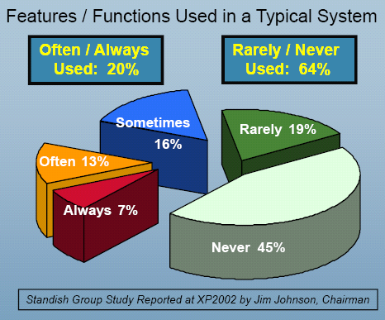
Why Prioritize?

Slide 12

Identifying Teams
It is preferable to have each team have the ability to complete its work by itself
In other words, instead of a team per component, have teams with members who have knowledge of each component that will need to change to deliver something
Don’t change the teams frequently

Slide 13


Components or Features?
Component teams provide expertise
But limit the ability to attack the highest priorities
And require more coordination (complexity)

Slide 14
Divvying Things Up
Your goal is to divvy things up so that teams are working on items of around the same priority
If each team able
to get 3 blocks in
the release,
the highlighted
stories won’t
make it
By better distributing
stories amongst the
teams, look which
stories won’t make it
Bad
Good

Slide 15

Dependencies
Approaches (go with the first one you can):
  Structure the teams so that a single team can solve the problem end to end
  Do the work within the same iteration
  Implement the service and then use it
  Stub out the service and implement it later
Make sure the dependent teams
  (including external ones) are represented at
  release planning

Slide 16

Understanding the Issues
Keep to the minimal responsible amount of doc
No more than you need at any point in time
  Just enough to understand dependencies and mitigate risks
  The right size for the problem
Do you need this now?
  If not, try to reduce or eliminate it

Slide 17

Agile Architecture
Just enough
Refactor as you go

Slide 18
Estimating
Identify a medium sized story that is well understood; call it a 5
Now estimate other stories relative to that
Is it about the same, ½ as difficult, twice as difficult?
Use Fibonacci numbers: 1, 2, 3, 5, 8, 13, 21
If bigger than that or if too hard to estimate, split the story

Slide 19
Why Story Points?
Time estimates
  Vary by person
  Encourage padding
  Tend to grow stale
Story points
  More consistent from person to person
  Not a commitment to time frame
  Don’t change as much
  Easier to estimate relative size

Slide 20
Velocity
Now that stories have sizes, you can track how many points you typically get done in an iteration
You can now use this to predict future completion rates

Slide 21
Story Points Across Teams
To get teams in the same ballpark, pick a baseline story
  Each team should understand the complexity
  Choose a medium size story
  Call it a ‘5’
  All other stories are relative to it
Don’t compare velocity
  Used by a team to evaluate itself
  If others use it for evaluation, it will be gamed and become useless

Slide 22
Definition of Done
Define what “Done” means for your team
Make “Done” more stringent over time
Definition of Done evolves as you do

Slide 23
Key Dates
How many iterations?
When do they start / stop?
Which iterations (if any) are hardening?
Any other dates to be mindful of?

Slide 24
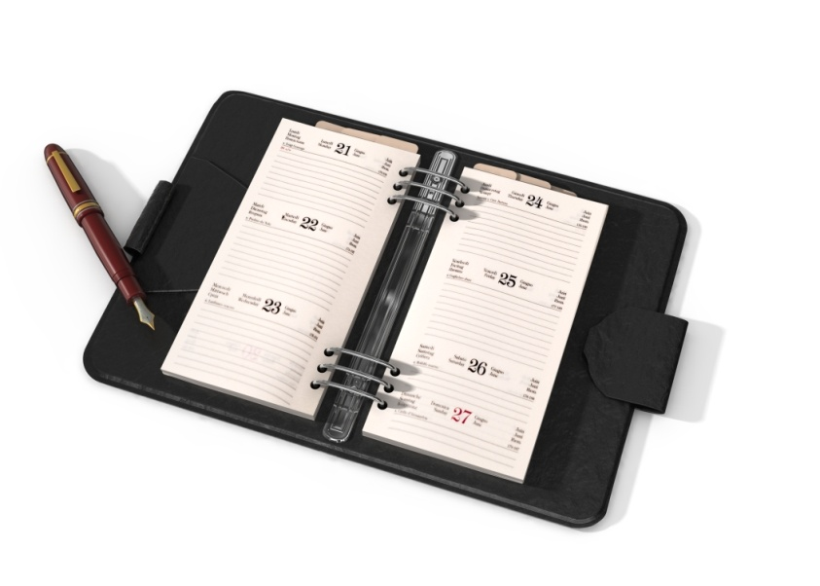
Release Planning
Kick off / Overview
Break Out Sessions
Review Results

Slide 25

Attendees
Product Owners
ScrumMasters
Architects / Leads
QA
Writers
Other Stakeholders
This is the best time to travel!

Slide 26

Release Planning Deliverables
Plan for each Iteration
Assumptions
Dependencies
Risks

Slide 27
Philosophies
Simple Is Better
  Allows for better coverage across features
  Prevent unnecessary complexity
    If you go too simple, it will remain unused until you follow up with the market demanded features next release
    If you go too complex, it is very difficult to identify and remove the unnecessary complexity
Leave Room To Be Agile
  No more than 70% of our time should be allocated to committed features

Slide 28
Release Planning Wrap Up
Go through each iteration for each team
Are things synched up across teams?
Are you attacking the most important stories?
Does the team believe in the results?

Slide 29

Is This Reasonable?
Everyone agrees the release is doable
Use disagreement and uneasiness in team members to drive out hidden risks, tasks, and issues
Drive agreement with a fist to five
    Absolutely, no question
    I think this is good and will make it happen
    I can support this
    I’m uneasy about this and think we need to talk it out some more
    Let’s continue discussing this idea in the parking lot

Slide 30
After The Meeting
Capture the results in your tool of choice
Update after each iteration
Notify of major changes to the plan

Slide 31
Communicating the Future
Themes give you room to be flexible
If a customer is asking about a particular feature, you can get into a discussion of priorities
Demos are a potential opportunity to get a customer involved
Smaller, incremental releases generate feedback on what to dig into in more detail

Slide 32
Prioritization Doesn’t Stop
The product owner re-prioritizes after each iteration
  We’ve learned more about the business
  Let’s take advantage of that
The further down the list something is, the less defined it will be and the less important it is to prioritize precisely

Slide 33

Questions?
Walter Bodwell
Planigle
  wbodwell@planigle.com
  Twitter: @wbodwell
  www.planigle.com
  www.walterbodwell.com

